Slide 1
Disaster Management Platform
By
Varadharajan R

Slide 2
What’s the Need ?
The main reason that triggered this idea was nothing but the humanity of the people who are eager to serve the victims of a natural catastrophic happening resulting in vain.
They are all mostly unaware about the exact location of the disaster and that is hardly intolerable to one such developmental era.

Slide 3
What’s the goal ?
Clearly the ultimate goal is to provide rescuers a better chance to help the victims.
Moreover guiding the rescuers to the disaster area is the task that I have taken in thereby ensuring the victims a chance for survival and rehabilitation.
The project is also aimed at conveying the exact situation and needs of the victim to anyone who is ready to help.
This can also serve as a community forum thereby uniting people in such hard or untackleable situations.
This platform thereby enhances the humanity of each and every individual who always look for the right people to lend their hand.

Slide 4
What’s the concern ?
Clearly the concern is to provide a 24*7 hosting of the site.
So that any kind of fault in connecting the website could be eliminated and this is always online.
There is a need for a backup server too.
The other concerns include better chances for the rescuers to communicate with the victims thereby serving their need.
The communication is made simple with the fruitful exploitation of Google Maps serving the victim’s location to the rescuer thereby maintaining the accuracy in connecting people.

Slide 5
Why Backup Server ?
Let’s get back to the past

Slide 6
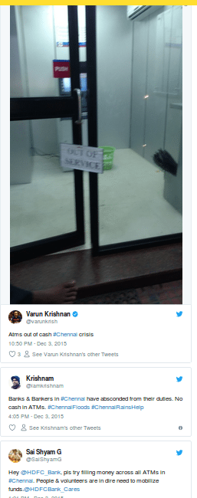
In Crisis the drowning of
bank servers would create
much chaos among the
people and may slower the
rate in which the people are
rescued.
The drowning of bank
servers is something
natural and a unexpected
catastrophic happening.
But to have a bank server
somewhere else could be a
better option.

Slide 7
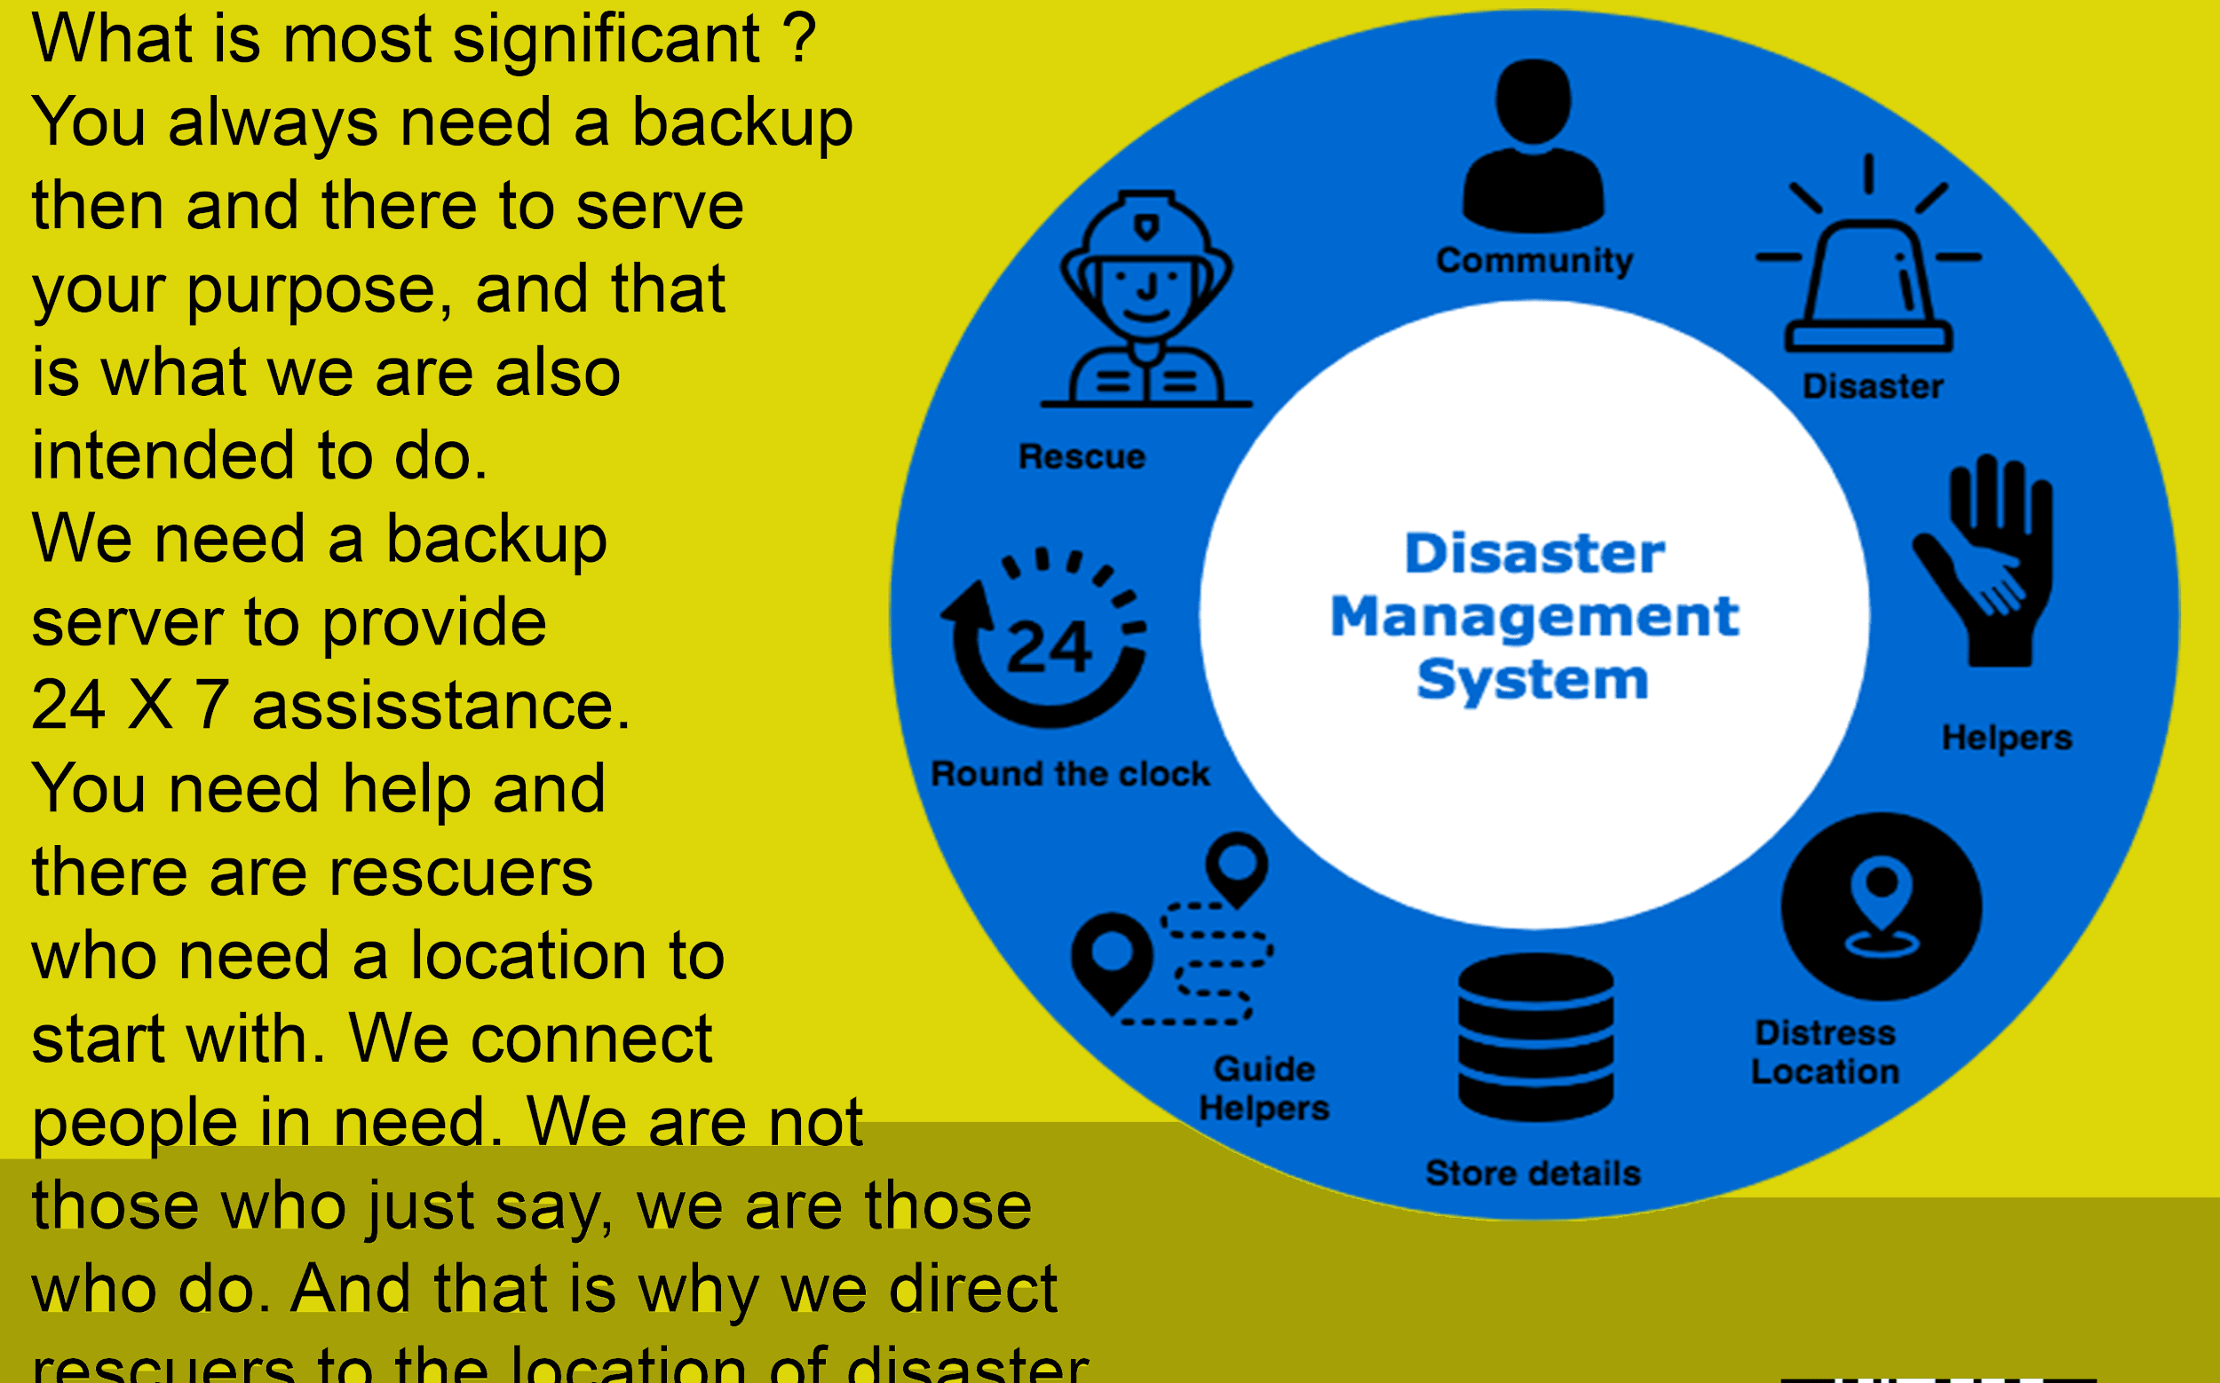
Working Model

Slide 8
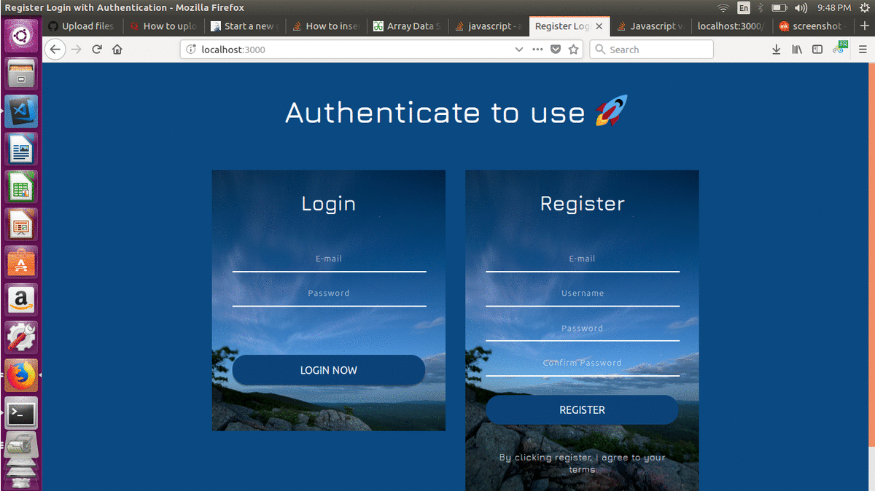
Glimpse of the Project

Slide 9
Thanks a lot.

